Slide 1

History of Pharmacopoeia and Impurities in pharmaceutical substances
Unit: Ist
Subject: Inorganic Pharmaceutical Chemistry (IPC)
Subject Code-BP-104T
B.Pharm(I Year)
SEMESTER: I
Deepa Bajetha
Associate Professor

Slide 2
About Pharmacopoeia
The book containing the standards for drugs and other related substances are known as pharmacopoeia and formularies collectively these books are known as drug compendia.
The word pharmacopoeia is derived from the Greek words “PHARMACON” meaning drug or medicine and “POEIO” means to make.
In other word it can be defined as the list of medicinal substances, crude drugs and also contain formula for preparing formulation.
It includes source, description, standard test, formula, action, use, dose and storage condition.

Slide 3
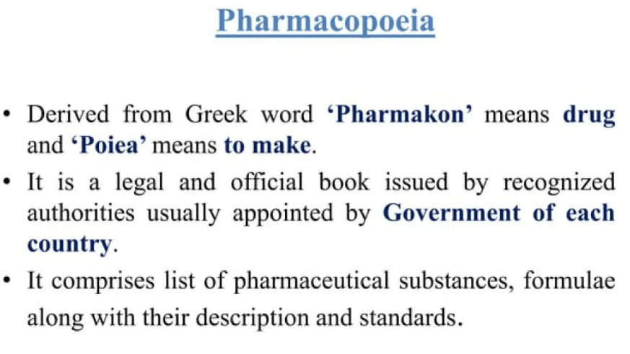
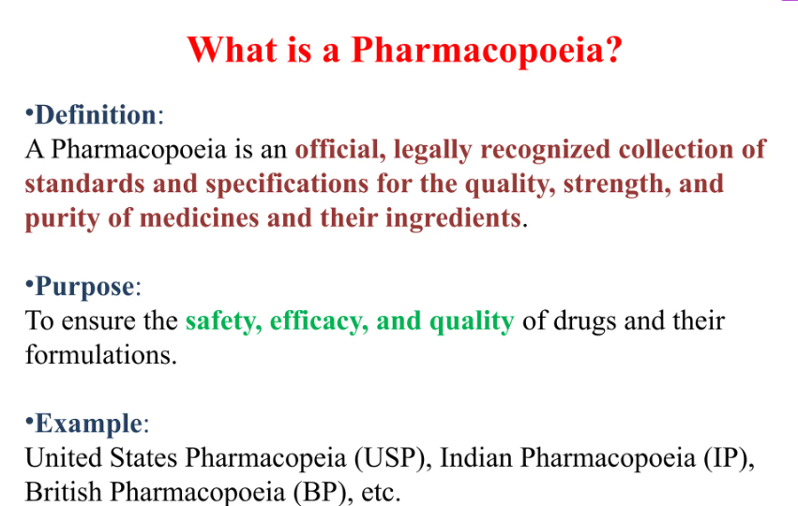
About Pharmacopoeia

Slide 4
History of Pharmacopoeia
These books are prepared under the authority of the Government of the respective countries
These book are revised time to time in order to update the latest information available
For the preparation of these books, the expert opinion of medical practitioner's, teachers and scientist and manufacturers are obtained

Slide 5
Classification of Pharmacopoeia
Classified as
Official Pharmacopoeia
Non-official Pharmacopoeia
Official Pharmacopoeia: These are the compilation of drugs and related substances which are recognized as legal standards for purity, quality and strength by a government agency of respective countries
Example: British Pharmacopoeia (BP) Indian Pharmacopoeia (IP)
United State Pharmacopoeia (USP)
National formulary (NF)

Slide 6

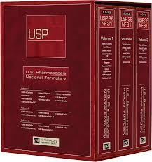
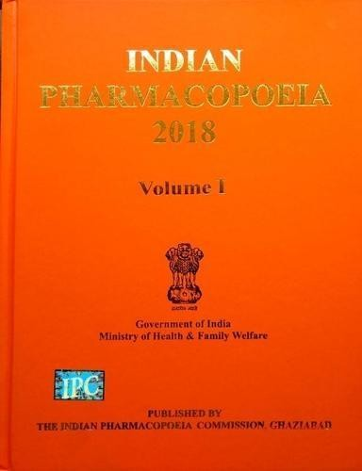

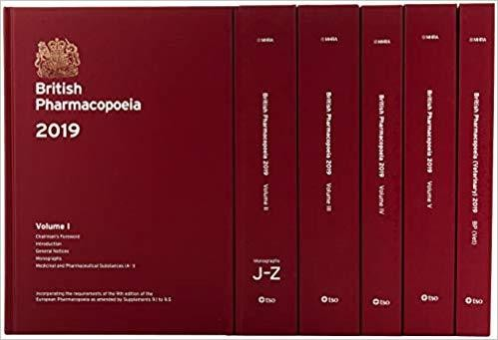
Pharmacopoeia

Slide 7
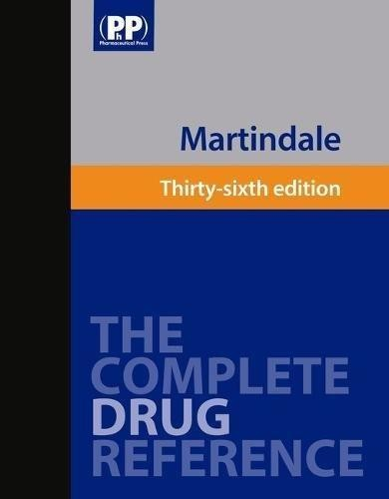
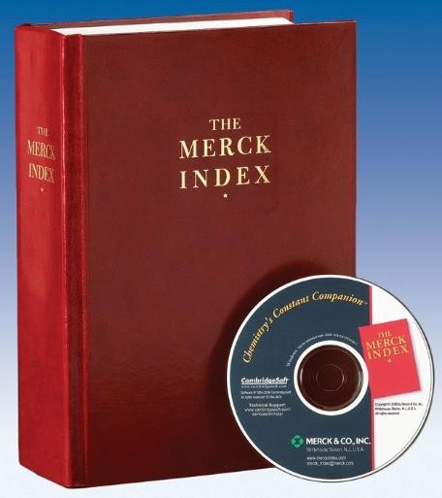
Classification of Pharmacopoeia
Non-official Pharmacopoeia: The book other than official drug compendia(comprehensive collection or summary of information)which are used as secondary references sources of drug and other related substances are known as non official drug compendia
Example: Merck index
Extra Pharmacopoeia (Martindale)
MIMS (Monthly Index of Medical Specialties)

Slide 8
History of Pharmacopoeia
The term pharmacopoeia first appears as a distinct title in a work published in Basel, Switzerland in 1561 by Dr. A. Foes, but does not appear to have come into general use until the beginning of the 17th century
Today’s pharmacopoeias mainly focuses on assurance of quality of products by various tool of analytical sciences

Slide 9
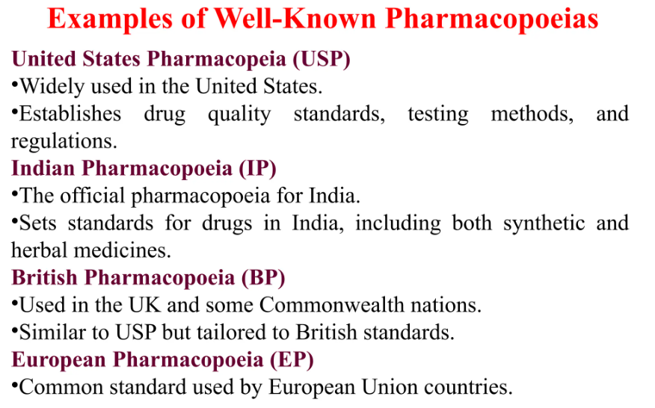

Slide 10
Indian Pharmacopoeia
First Pharmacopeia of India appeared in 1868 which was edited by Edward John Waring.
In pro-independence era, British Pharmacopeia was used in India.
The addendum (supplementary) of BP 1898 was published in 1900 appeared as Government of India edition in 1901
In 1946 Government of India issued one list known as “The Indian Pharmacopoeial list”

Slide 11
Indian Pharmacopoeia
Committee under chairmanship of Sir R. N. Chopra along with other nine members prepared “ The Indian Pharmacopoeial list”
It was prepared by Dept. of Health, Govt. of India, Delhi in 1946
In 1948 Government of India appointed an Indian Pharmacopeia committee for preparing “Pharmacopeia of India”
Tenure of this committee was five years
Indian Pharmacopeia committee under chairmanship of Dr. B. N. Ghosh Published first edition of IP in 1955

Slide 12
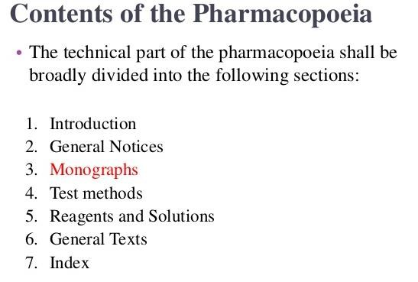

Slide 13
Monograph
Monograph is a document which defines pharmaceutical Substances and provides information for its proper identification.
The Pharmacopoeial monograph gives the following information about the drug and pharmaceutical aids:
Main Title
Synonyms
Chemical formula and molecular weight
Category
Doses
Description
Solubility: According to IP, solubilities of substances are mentioned in terms of description as follow

Slide 14
Monograph
Descriptive term | Approximate volume of the solvent for 1 gram of solute
Very soluble | Less than 1 mL
Freely soluble | From 1 to 10 mL
Soluble | From 10 to 30 mL
Sparingly soluble | From 30 to 100 mL
Slightly soluble | From 100 to 1000 mL
Very slightly soluble | From 1000 to 10000 mL
Practically insoluble | More than 10000 mL
h) Standard: Prescribe the standards of purity and strength example: sodium chloride IP contain not less than 99% and more than 100.5% of NaCl
i) Identification: this include some specific and non specific test for identity of substance.

Slide 15
Monograph
Test of purity: these test include melting, boiling point, limit test for metals, specific optical rotation
Method of assay: the term assay is used in pharmacopoeia for quantitative determination of principal ingredient
Storage: some specific condition for storage

Slide 16
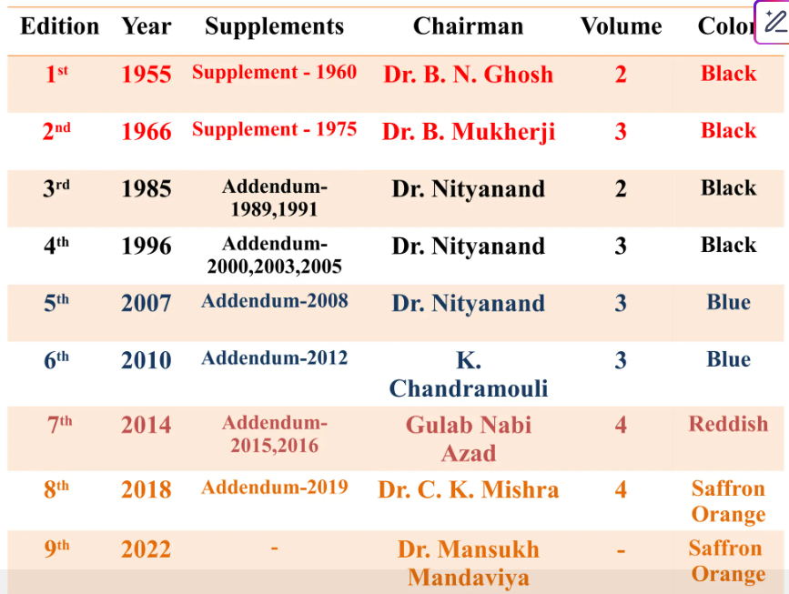
Addendum2024
4

Slide 17
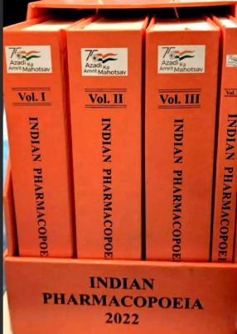

Slide 18
Impurities in pharmaceutical substances
Impurity: The impurities in drug are any unwanted chemical that remain with active pharmaceutical ingredients (API), developed during formulation and upon ageing of API or drug product.
A compound is said to be impure if it has the presence of foreign matter, i.e., Impurities
The presence of these unwanted chemicals even in trace amount may influence the efficacy and safety of pharmaceutical products
The International Conference on Harmonization (ICH) has formulated a workable guideline regarding the control of impurities

Slide 19
Types of Impurities
Types of Impurities
Organic Impurities
Inorganic Impurities
Residual Solvents
Starting Material
By- Product
Intermediates
Degradation Products
Reagents, Catalyst and Ligands
Reagents, Catalyst and Ligands
Inorganic salts
Heavy Metals or other residual metals
Other material (eg: charcoal)
Class 1 : Solvents to be avoided
Class 2 : Solvents to be Limited
Class 3 : Solvents with low toxic potential

Slide 20
Impurities in pharmaceutical substances
a)Organic Impurities :
Organic impurities may arise during manufacturing process or storage of the drug substance which includes starting material, by-product, intermediates, degradation products, reagents, ligand, catalyst and enantiomeric impurity.
Starting material impurity
Starting material can be a lead impurity if reaction is stopped before completion, as we can see in scheme, if starting material is 60% consumed and reaction stopped and the remaining 40% starting material will be an impurity in finished product like paracetamol.

Slide 21
Impurities in pharmaceutical substances
By product impurity
In synthetic chemistry, getting a single end product with 100% yield is very rare as there is always a chance of some by product with desired end product.
Example: In case of paracetamol synthesis, O-acyl paracetamol can be formed as by-product.
b)Inorganic Impurities
Inorganic impurities involve reagents, ligands, catalyst, heavy metals, or residual metals, inorganic salts, filter aids, charcoal etc. Inorganic impurity may also derive from the manufacturing process used for the API preparation.
•Reagents, Ligands and Catalyst
The chances of having these impurities are rare but in some process these can create problem unless the manufacturer take proper care during production.

Slide 22
Impurities in pharmaceutical substances
Residual solvents - Residual solvents are potentially undesirable substances. They either modify the properties of certain compounds or may be hazardous to human health.
The residual solvents also affect physicochemical properties of the bulk drug substances such as crystallinity of bulk drug, which in turn may affect the dissolution properties, odour and colour changes in finished products.
As per the ICH guidelines, the solvents used in the manufacturing of drug substances classified into various types .

Slide 23
Residual Solvents
Class-1
Class-2
Class-3
Benzene
Carbon Tetra Chloride
1,2-Dichloro Ethane
1,1-Dichloro Ethane
1,1,1-Trichloro Ethane
Acetonitrile
Chloro Benzene
Cumene
Cyclo Hexane
Acetic Acid
Acetone
Ethanol
Pentane
Triethylamine (TEA)

Slide 24
Sources of impurities
Raw material used in manufacture
Reagents used in manufacturing process
Method/process used in manufacture or method of manufacturing
Chemical process used in the manufacture
Atmospheric contamination during the manufacturing process
Intermediate products in the manufacturing process
Defects in the manufacturing process
Manufacturing hazards
Inadequate storage conditions
Decomposition of the product during storage
Accidental substitution

Slide 25
Raw materials used in the manufacture
Impurities known to be associated with these chemicals may be carried through the manufacturing process and contaminate the final product.
Cu+2H₂SO₄ CuSO₄+2H₂O+SO₂
Copper turning have Iron and Arsenic impurities.
So, I.P. prescribes limit of tolerance for arsenic as impurity to be not more than 8 ppm in copper sulphate.

Slide 26
Method or process used in manufacture
The Process or method of manufacture may introduce new impurities.
Due to impure reagents, catalysts and solvents, reaction vessels and reaction intermediates employed at various stages.
Reagents used in the manufacturing process–
If reagents used in the manufacturing process are not completely removed by washing, these may find entry into the final product.
CaCl₂+Na₂CO₃ CaCO₃+2NaCl
(soluble) (soluble) (ppt.) (soluble)
Precipitate is washed with water to remove excess of sodium carbonate and soluble chloride.

Slide 27
ppt. is not washed properly, impurities remain present in final product.
I.P. prescribe limits of tolerance for soluble alkali(Na₂CO₃) and chlorides
Anions like Cl⁻ and SO4⁻² are common impurities in many substances because of the use of hydrochloric acid and sulphuric acid respectively.
Barium ion may be an impurity in hydrogen peroxide.

Slide 28
Impurities present in Intermediates
Sometimes, an intermediate substance produced during the manufacturing process may contaminate the final product
e.g.Sodium bromide is prepared by reaction of sodium hydroxide and bromine inslight excess.
6NaOH+3Br₂→NaBrO₃+5NaBr+3H₂O
•The sodium bromate an intermediate product is reduced to sodium bromide by heating the residue with charcoal.
NaBrO₃+3C→NaBr+3CO
If sodium bromate is not completely converted to the sodium bromide the nit is likely to be present as an impurity.

Slide 29
Reagents and solvents
Reagent added to remove other impurities
Barium is used to remove sulphate from potassium bromide, which can be found itself (barium) as impurity at the end of process.
Solvents
Small amounts of solvents employed in preparation, and purification of the product may also result in the contamination of the pharmaceutical substances.
Water is the cheapest solvent which can be the major source of impurities as it contains different type of impurities like Ca₂+,Mg₂+,Na+,Cl-, and SO4⁻² in trace amounts.

Slide 30
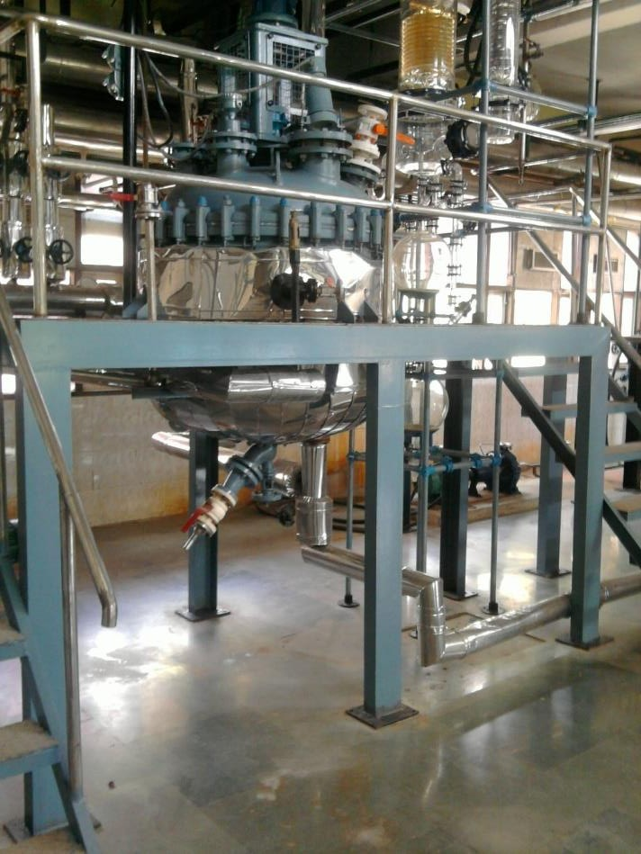
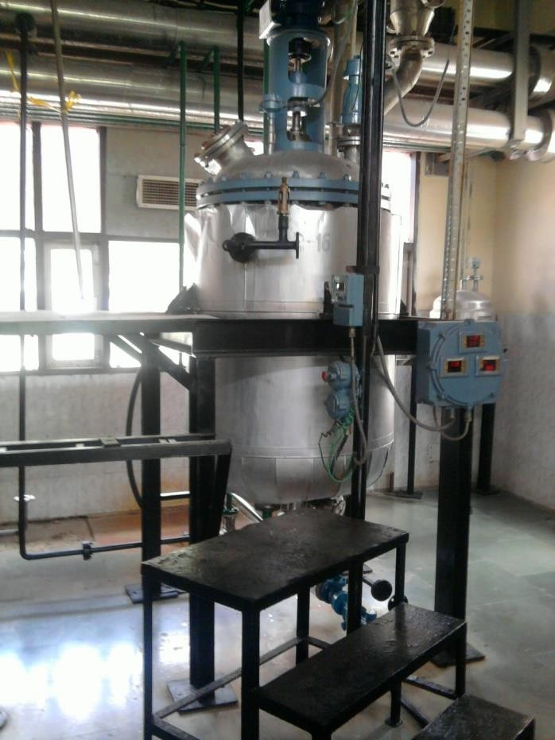
Reagents and solvents
Reaction vessel: Reaction vessel employed in the manufacturing process may be metallic such as copper, iron, glass , silica. Sometime these can react with reagents and led to generate inorganic impurity as salts.

Slide 31
Chemical process used in the manufacture
The synthesis of drugs requires the use of various chemical reactions like nitration, halogenation, oxidation, reduction, hydrolysis, etc., where by-products are performed during the reaction and result in contamination.
E.g. Potassium iodide is manufactured from iodine, which is obtained from ‘kelp’, a sea weed. Cyanides are formed when nitrogenous organic matter is burnt with alkalis, which result in contamination.

Slide 32
e)Atmospheric contamination during the manufacturing process:
•Atmosphere may contain dust (aluminiumoxide, sulphur, silica etc.) and some gases like carbon dioxide, sulphurdioxide, arsine and hydrogen sulphide.
•These may contaminate the final product during the manufacturing process.
•e.g. sodium hydroxide readily absorbs atmospheric carbon dioxide when exposed to atmosphere.
2NaOH + CO₂→ Na₂CO₃+ H₂O

Slide 33
Manufacturing hazards:
If the manufacturer is able to control and check impurities from the all above mentioned sources the reexists certain manufacturing hazards which can lead to product contamination.
a)Contamination from the particulate matter:
•The unwanted particulate matter can arise by accidental introduction of dirt or glass, porcelain, plastic or metallic fragments from sieves, granulating, tableting and filling machines and the product container.
b)Cross-contamination of the product:
•Cross-contamination of product can occur by air-born dust arising out of handling of powders, granules and tablets in bulk.
•If 2 or more Products are manufactured in same time this type of contamination is possible.

Slide 34
c)Contamination by microbes:
Many products, like liquid preparations and creams intended for topical applications are liable to contamination by microbes from the atmosphere during manufacturing.
Microbes like Bacteria, fungi, Algae etc. Can contaminate the final product.
d)Errors in the manufacturing process:
Sometimes in a liquid preparation, there is incomplete solution of the solute.
Aerroron the efficiency of mixing, filling, tableting, sterilization etc. Arise impurity in final product.
e)Errors in the packaging:
Similar looking products, such as tablets of the same size, shape and color, packed in similar container scan result in mislabeling of either or both of the products.

Slide 35
Storage condition
Stored product may become contaminated with dust, the bodies of insects, unless adequate precautions are taken.
Chemical instability: Impurities can also arise during storage because of chemical instability of pharmaceutical substance.
Reaction with container materials: The possibility of reaction between container and content constituents a hazard which cannot be ignored eg. Salicylic acid ointment.
Temperature effects: The rate at which chemical and also physical change in stored products is conditioned by temperature, and labile products may have temperature storage requirements assigned to them to guard against unnecessary decomposition.

Slide 36
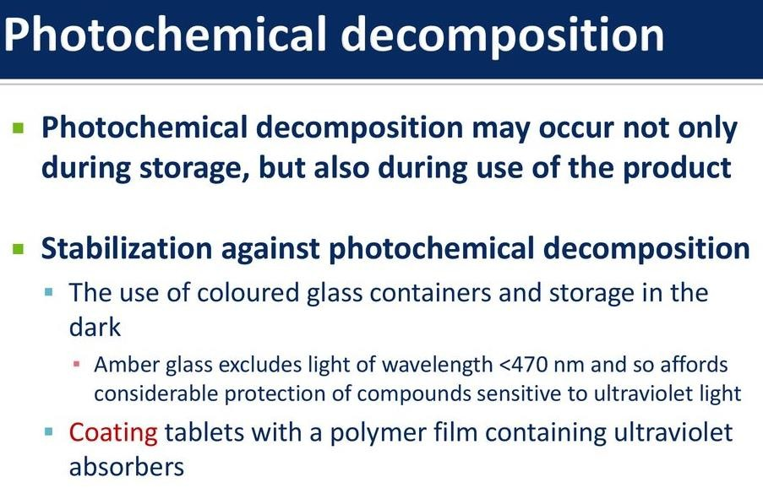
Decomposition of the product during storage
Some substance decomposes on keeping. The decomposition becomes greater in the presence of light-air or oxygen.
The result of decomposition brings about contamination of the final product.
Substances absorb water of crystallization lose it on being kept open, eg amine, phenol etc.

Slide 37
Limit test
The impurities commonly present in chemical substances may include small quantities of lead, arsenic, iron, chloride, sulphate and heavy metals.
Presence of impurities in pharmaceutical substance may be produce toxic effect in the body and also lower down active strength of pharmaceutical substance. As it is not practicable to prepare all chemicals entirely free from these impurities, limits compatible with manufacturing conditions must be prescribed.
Limit tests are defined as quantitative or semi-quantitative tests designed to identify and control small quantitates of impurity, which are likely to be present in the substance.

Slide 38
Limit test
Pharmacopoeia do not prescribe any numerical value of limit test for chlorides, sulphates and iron because limit test is based on simple comparison of opalescence or turbidity or colour between test and standard solution prescribed according to pharmacopoeia.
The variation occurs in opalescence or turbidity or colour may be due to presence of other impurities in the substance. Hence the pharmacopoeia does not prescribe any numerical values for limit test.

Slide 39
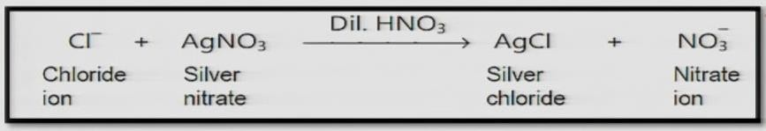
Limit test for chloride
Principal:
The limit test of chloride is based on the reaction between soluble chloride impurities present in the sample and silver nitrate solution to form white precipitates of silver chloride.
These precipitates are insoluble in dilute HNO₃ and hence give turbidity or opalescence to the test solution.

Slide 40
Limit test for chloride
Test sample
1. Specific weight of compound is dissolved in water or solution is prepared as directed in the pharmacopoeia and transferred in Nessler cylinder.
2. Add 1ml of dil. nitric acid
3. Dilute to 50ml in Nessler cylinder
4. Add 1ml of AgNO₃ solution
5. Keep aside for 5 min
6. Observe the Opalescence/Turbidity
Standard compound
1. Take 1ml of 0.05845 % W/V solution of sodium chloride in Nessler cylinder.
Add 1ml of dil. nitric acid
Dilute to 50ml in Nessler cylinder
Add 1ml of AgNO₃ solution
Keep aside for 5 min
Observe the Opalescence/Turbidity

Slide 41
Limit test for chloride
The opalescence produce in sample solution should not be greater than standard solution. If opalescence produces in sample solution is less than the standard solution, the sample will pass the limit test of chloride and visa versa.
Reasons:
Nitric acid is added in the limit test of chloride to make solution acidic and helps silver chloride precipitate to make solution turbid at the end of process. Nitric acid dissolved other impurities & AgCl precipitate is insoluble in Nitric acid.

Slide 42
Limit test for sulphate
Principle:
It involves the comparison of opalescence or turbidity of test sample with standard sample which contain the definite amount of sulphate impurities.
SO₄⁻
(Soluble)
+ BaCl₂
dil. HCl
BaSO₄
(insoluble)
+ 2Cl⁻

Slide 43
Limit test for sulphate
Limit test based on reaction between BaCl₂ reagent and soluble sulphate present in sample with formation of BaSO₄ as white turbidity or opalescence. Sulphate free alcoholic K₂SO₄ is added to increase the sensitivity of the test. Very small amount of barium sulphate present in the reagent acts as a seeding agents for precipitation of BaSO₄ if sulphate is present in the sample. Ethanol is added to prevent the super saturation.
Preparation of ethanolic sulphate standard solution (10 ppm SO₄²⁻): Dilute 1 volume of a 0.181% w/v solution of potassium sulphate in ethanol (30%) to 100 volumes with ethanol (30%).
Preparation of sulphate standard solution (10 ppm SO₄²⁻): Dilute 1 volume of a 0.181% w/v solution of potassium sulphate in distilled water to 100 volumes with distilled water.

Slide 44
Limit test for sulphate
Test sample | Standard compound
Specific weight of compound is dissolved in water or solution is prepared as directed in the pharmacopoeia and transferred in Nessler cylinder | Take 1ml of 0.1089 % W/V solution of potassium sulphate in Nessler cylinder
Add 2ml of dilute HCl | Add 2ml of dilute HCl
Dilute to 45ml in Nessler cylinder | Dilute to 45ml in Nessler cylinder
Add 5ml of BaSO₄ reagent | Add 5ml of BaSO₄ reagent
Keep aside for 5 min | Keep aside for 5 min
Observe the Turbidity | Observe the Turbidity

Slide 45
Limit test for sulphate
Observation: The turbidity produce in sample solution should not be greater than standard solution. If turbidity produces in sample solution is less than the standard solution, the sample will pass the limit test of sulphate and vice versa.
Reasons:
Hydrochloric acid helps to make solution acidic.
Potassium sulphate is used to increase the sensitivity of the test by giving ionic concentration in the reagent
Alcohol helps to prevent super saturation.

Slide 46
Limit test for Iron
Principle: Limit test of Iron is based on the reaction of iron in ammonical solution with thioglycollic acid in presence of citric acid to form iron thioglycolate which is pale pink to deep reddish purple in color.

Slide 47
Limit test for Iron
Test sample | Standard compound (20ppm Fe)
Sample is dissolved in specific amount of water and then volume is made up to 40 ml | 2 ml of standard solution of iron diluted with water upto 40ml
Add 2 ml of 20 % w/v of citric acid (iron free) | Add 2 ml of 20 % w/v of citric acid (iron free)
Add 2 drops of thioglycollic acid | Add 2 drops of thioglycollic acid
Add ammonia to make the solution alkaline and adjust the volume to 50 ml | Add ammonia to make the solution alkaline and adjust the volume to 50 ml
Keep aside for 5 min | Keep aside for 5 min
Color developed is viewed vertically and compared with Standard solution | Color developed isviewed vertically and compared with Standard solution

Slide 48
Limit test for Iron
Iron Standard Solution (20 ppm Fe): Dilute 1 volume of a 0.1726 per cent w/v solution of ferric ammonium sulphate in 0.05 M sulphuric acid to 10 volumes with water. Contains iron in ferric state.
Earlier ammonium thiocyanate reagent was used for the limit test of iron. Since thioglycolic acid is more sensitive reagent, it has replaced ammonium thiocyanate in the test.
Observation: The purple color produce in sample solution should not be greater than standard solution. If purple color produces in sample solution is less than the standard solution, the sample will pass the limit test of iron and vice versa.
Reasons:
Citric acid helps in to prevent precipitation of iron by ammonia by forming a complex with it.
Thioglycolic acid helps to oxidize iron (II) to iron (III).
Ammonia to make solution alkaline

Slide 49
Limit test for Arsenic
Principle:
Limit test of Arsenic is based on the reaction of arsenic gas with hydrogen ion to form yellow stain on mercuric chloride paper in presence of reducing agents like potassium iodide.
It is also called as Gutzeit test and. requires special apparatus Arsenic, present as arsenic acid in the sample is reduced to arsenious acid by reducing agents like potassium iodide, stannous acid, zinc, hydrochloric acid, etc.
Arsenious acid is further reduced to arsine (gas) by hydrogen and reacts with
mercuric chloride paper to give a yellow stain.

Slide 50
Limit test for Arsenic
H₃AsO₄ + H₂SnO₂ → H₃AsO₃ + H₂SnO₃
Arsenic acid Arsenious acid
H₃AsO₃ + 3H₂ → AsH₃ + 3H₂O
Arsenious acid Arsine
The depth of yellow stain on mercuric chloride paper will depend upon the quality of arsenic present in the sample.

Slide 51
Limit test for Arsenic
Test solution:
The test solution is prepared by dissolving specific amo nt in water and stannated HCl (arsenic free) and kept in a wide mouthed bottle. To this solution 1 gm of KI, 5 ml of stannous chloride a id solution and 10 gm of zinc is added (all this reagents must be arsenic free) Keep the solution aside for 40 min and stain obtained on mercuric chloride paper is compared with standard solution.
Standard solution:
A known quantity of dilute arsenic solution is kept in wide mouthed bottle and rest procedure is followed as described in test solution.

Slide 52
Limit test for Arsenic
Reasons :-
Stannous chloride is used for complete evolution of arsine
Zinc, potassium iodide and stannous chloride is used as a reducing agent.
Hydrochloride acid is used to make the solution acidic
Leas acetate pledge or papers are used to trap any hydrogen sulphide which may be evolved along with arsine.

Slide 53
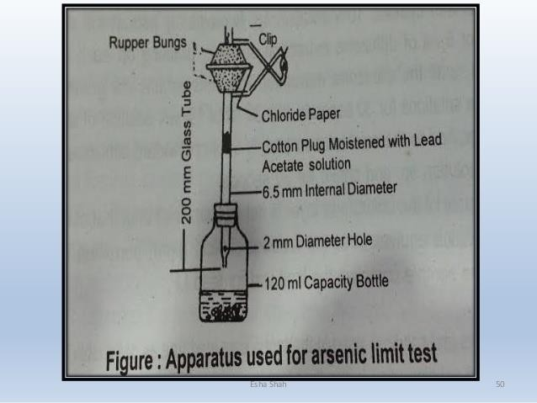
Gutzeit apparatus for the arsenic limit test

Slide 54
Limit test of Lead
Lead is a most undesirable impurity in medical compounds and comes through use of sulphuric acid, lead lined apparatus and glass bottles use for storage of chemicals.
Principle:
Limit test of lead is based on the reaction of lead and diphenyl thiocabazone (dithizone) in alkaline solution to form lead dithizone co mplex which is read in color.
Dithizone is green in color in chloroform and lead-dithizone complex is violet in color, so the resulting color at the end of process is red.
Procedure:

Slide 55
Limit test of Lead
Dithizone in chloroform, is able to extract lead from alkaline aqueous solutions as a lead dithizone complex (Red in colour)
The original dithizone is having a green colour in chloroform while the lead- dithizone is having a violet color. So, resulting color at the end of the process is read.
The intensity of the color of complex is dependant upon the amount of lead in the solution.
The color of the lead-dithizone complex in chloroform has been compared with astandard volume of lead solution, treated in the same manner.
In this method, the lead present as an impurity in the substances, gets separated by extracting an alkaline solution with a dithizone extraction solution.
The interference and influence of the other metal ions has been eliminated byadjusting the optimum pH for the extraction by employing ammonium citrate/ potassium cyanide.

Slide 56
Limit test of Lead - Procedure:
Standard sample
A standard lead solution is prepared equivalent to the amount of lead permitted in the sample under examination Add 6ml of ammonium citrate
Add 2 ml of potassium cyanide and 2 ml of hydroxylamine hydrochloride
Add 2 drops of phenol red
Make solution alkaline by adding ammonia solution.
Extract with 5 ml of dithizone until it becomes green
Combine dithizone extracts are shaken for 30 mins with 30 ml of nitric acid & the chloroform layer is discarded
To the acid solution add 5 ml of standard dithizone solution. Add 4 ml of ammonium cyanide. Shake for 30 mins.
Observe the color
Test sample
A known quantity of sample solution is transferred in a separating funnel. Add 6ml of ammonium citrate
Add 2 ml of potassium cyanide and 2 ml of hydroxylamine hydrochloride
Add 2 drops of phenol red
Make solution alkaline by adding ammonia solution.
Extract with 5 ml of dithizone until it becomes green
Combine dithizone extracts are shaken for 30 mins with 30 ml of nitric acid & the chloroform layer is discarded
To the acid solution add 5 ml of standard dithizone solution. Add 4 ml of ammonium cyanide. Shake for 30 mins
Observe the color

Slide 57
Limit test of Lead
Observation:
The intensity of the color of complex, is depends on the amount of lead in the solution. The color produce in sample solution should not be greater th n standard solution. If color produces in sample solution is less than the standard solution, the sample will pass the limit test of lead and vice versa.
Reasons:
Ammonium citrate, potassium cyanide, hydroxy amine hydrochloride is used to make pH optimum so interference and influence of other impurities ha e been eliminated.
Phenol red is used as indicator to develop the color at the end of process
Lead present as an impurities in the substance, gets separated bye extracting an alkaline solution with a dithizone extraction solution.

Slide 58
Limit test of Heavy Metals
Principle: Limit test of heavy metals is based on the reaction of metallic impurities with
hydrogen sulphide in acidic medium to form brownish colour solution. Metals that response to this test are lead, mercury ,bismuth, arsenic, antimony , tin, cadmium, silver , copper , and molybdenum.
The metallic impurities in substances are expressed as parts of lead per million parts of the substance. The usual limit as per Indian Pharmacopoeia is 20 ppm.

Slide 59
Limit test of Heavy Metals
Procedure: The I.P. has adopted three methods for the limit test of heavy metals.
Method-I: Use for the substance which gives clear colorless solution under the specific condition.
Test sample
Solution is prepared as per the monograph and 25 ml is transferred in Nessler’s cylinder.
Adjust the pH between 3 to 4 by adding dilute acetic acid2. ‘Sp’ or dilute ammonia solution ‘Sp’
Dilute with water to 35 ml
Add freshly prepared 10 ml of hydrogen sulphide solution
Dilute with water to 50 ml
Allow to stand for five minutes
View downwards over a white surface
Standard sample
1. Take 2 ml of standard lead solution and dilute to 25 ml with water
2. Adjust the pH between 3 to 4 by adding dilute acetic acid ‘Sp’ or dilute ammonia solution ‘Sp’
Dilute with water to 35 ml
Add freshly prepared 10 ml of hydrogen sulphide solution
Dilute with water to 50 ml
Allow to stand for five minutes
View downwards over a white surface

Slide 60
Limit test of Heavy Metals
Observation:
The color produce in sample(Test) solution should not be greater than standard solution. If color produces in sample solution is less than the standard solution, the sample will pass the limit test of heavy metals & vice versa.
Method II:
Use for the substance which do not give clear colorless solution under the specific condition.

Slide 61
Limit test of Heavy Metals
Test sample
Weigh specific quantity of test substance, moisten with sulphuric acid and ignite on a low flame till completely charred. Add few drops of nitric acid and heat to 500 °C. Allow to cool and add 4 ml of HCL and evaporate to dryness Moisten the residue with 10 ml of HCl and digest for two minutes. Neutralize with ammonia solution and make just acid with acetic acid
Adjust the pH between 3 to 4 and filter if necessary
Dilute with water to 35 ml
Add freshly prepared 10 ml of hydrogen sulphide solution
Dilute with water to 50 ml. Allow to stand for five minutes
View downwards over a white surface
Standard Sample
1. Take 2 ml of standard lead solution and dilute to 25 ml with water.
Adjust the pH between 3 to 4 by adding dilute acetic acid ‘Sp’ or dilute ammonia solution ‘Sp’
Dilute with water to 35 ml
Add freshly prepared 10 ml of hydrogen sulphide solution
Dilute with water to 50 ml
Allow to stand for five minutes
View downwards over a white surface.

Slide 62
Limit test of Heavy Metals
Observation:
The color produce in sample solution should not be greater than standard solution. If color produces in sample solution is less than the standard solution, the sample will pass the limit test of heavy metals and vice versa.
Method III:
Use for the substance which gives clear colorless solution in sodium hydroxide solution.

Slide 63
Limit test of Heavy Metals
Test sample
1. Solution is prepared as per the monograph and 25ml is transferred in Nessler’s cylinder or weigh specific amount of substance and dissolve in 20 ml of water and add 5 ml of dilute sodium hydroxide solution. Make up the volume to 50 ml with water
Add 5 drops of sodium sulphide solution
Mix and set aside for 5 min
View downwards over a white surface
Standard sample
1. Take 2 ml of standard lead solution
Make up the volume to 50 ml with water
Add 5 drops of sodium sulphide solution
Mix and set aside for 5 min
View downwards over a white surface
Observation:
The color produce in sample solution should not be greater than standard solution. If color produces in sample solution is less than the standard solution, the sample will pass the limit test of heavy metals and vice versa.

Slide 64
Modified Limit test of chloride
Principle :-
Limit test of chloride is based on the precipitation reaction. The precipitates of chlorides develop on reaction of soluble chloride with silver nitrate in the presence of dilute nitric acid to form silver chloride, which appears as solid particles (opalescence) in the solution. The Intensity of turbidity depends on the amount of chlorides present in the test substance.
+ AgNo₃ AgCl + HNo₃
Silver nitrate Silver chloride Nitric acid
Procedure :-
With reference to International Pharmacopoeia 6 Edition 2016, the limit test of chloride has been modified in the context of standard solution preparation. Earlier the standard solution of chloride was prepared by dissolving sodium chloride (NaCl, known " impurity) but now it has been modified by using hydrochloric acid (HCI) instead of sodium chloride (NaCl)
HCl
^{Hydrochloric} ^{acid}

Slide 65
Modified Limit test of sulphate
Principle :-
The principle involved in the limit test for sulphates is precipitation method. The sulphates are precipitated as barium sulphates by reacting with barium chlorides in the presence of hydrochloric acid. The hydrochloric acid used prevents the reaction of other acid radicals with barium chlorides as in the presence of hydrochloric acid, only sulphates are precipitated.
+ BaCl₂ BaSO₄ + 2Cl ⁻
Due to the formation of precipitates, the solution appears turbid and the extent of turbidity depends on the amount of sulphates present. If the turbididty produced by the test is less than that of standard , it means that the sample contains sulphates within prescribed limits.
So₄

Slide 66
Modified Limit test of sulphate
Reagent Preparations:
Barium Sulphate Reagent: Dissolve 12g of barium chloride (BaCl₂.2H₂O) in 1000 ml of water to make 0.05M barium chloride solution. To 15 ml of the prepared solution add 55 ml water, 20 ml alcohol, 5 ml of 0.0181% w/v potassium sulphate (K₂SO solution and makeup the volume upto 100 ml.
Standard Potassium Sulphate Solution: Accurately weighed 0.1089g of K₂SO₄ and the volume was made upto 100 ml with water.
Test sample: Sodium Chloride: Dissolve 2g of sodium chloride in 20 ml of water.
Sodium bicarbonate: Dissolve 2g of sodium bicarbonate in little quantity of water.
Conclusion:
If opalescence produced in the standard is more than that of test, the sample complies the limit test of sulphate as per L.P.

